Slide 1
First Help Financial Loan Default Risk Analysis
Scott Hunter

Slide 2
Executive Summary
We wish to reduce the risk of default on a loan by utilizing new applicant characteristics that will best predict the likelihood of default.
Based upon the loan outcomes of 1000 prior new applicants, we can conclude that the following new applicant characteristics are most predictive of loan outcomes:
Loan Amount
Presence of a Checking Account
Installment Rate (As a % of Disposable Income)

Slide 3
Predictors of Loan Outcome
Results of Logistic Regression Model

Slide 4
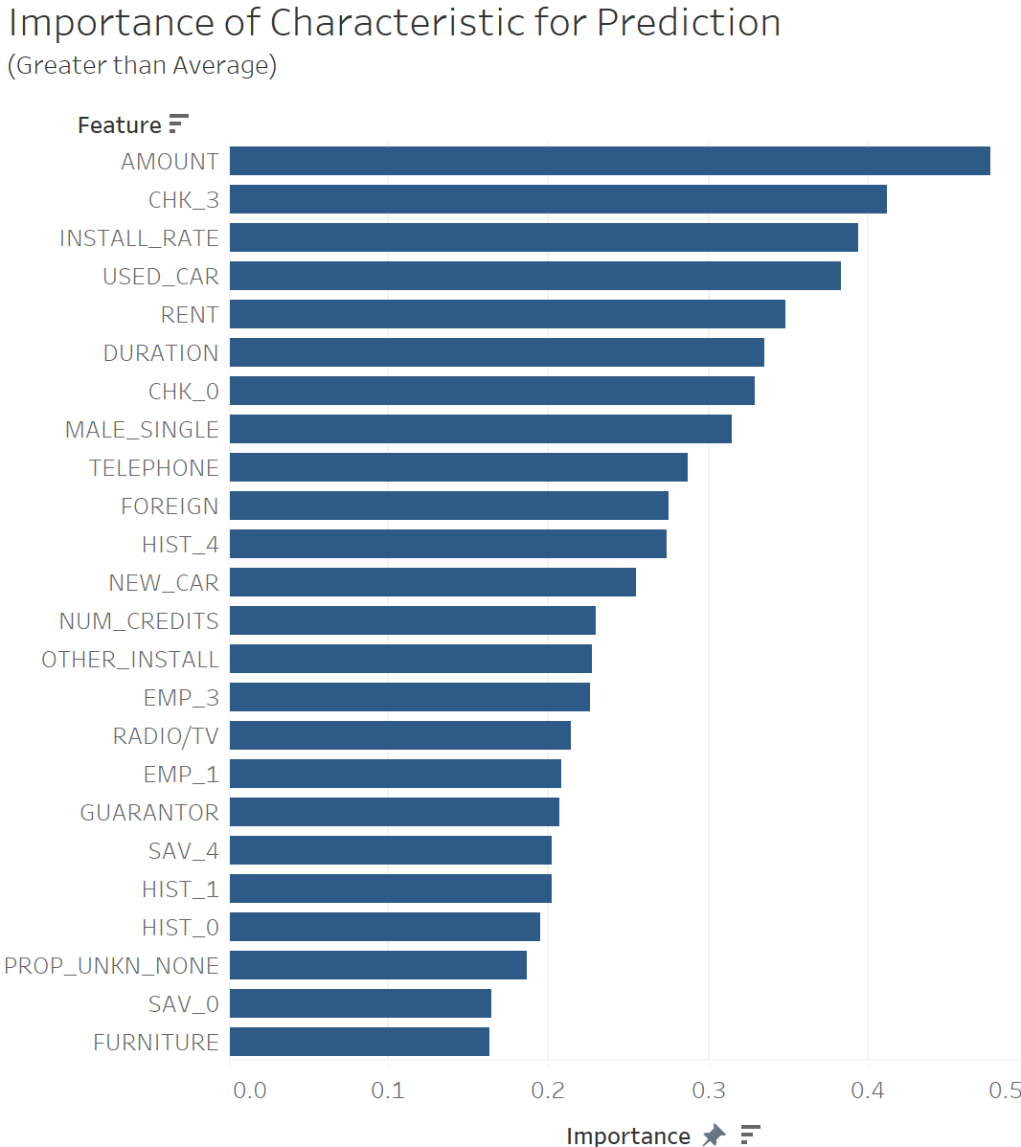
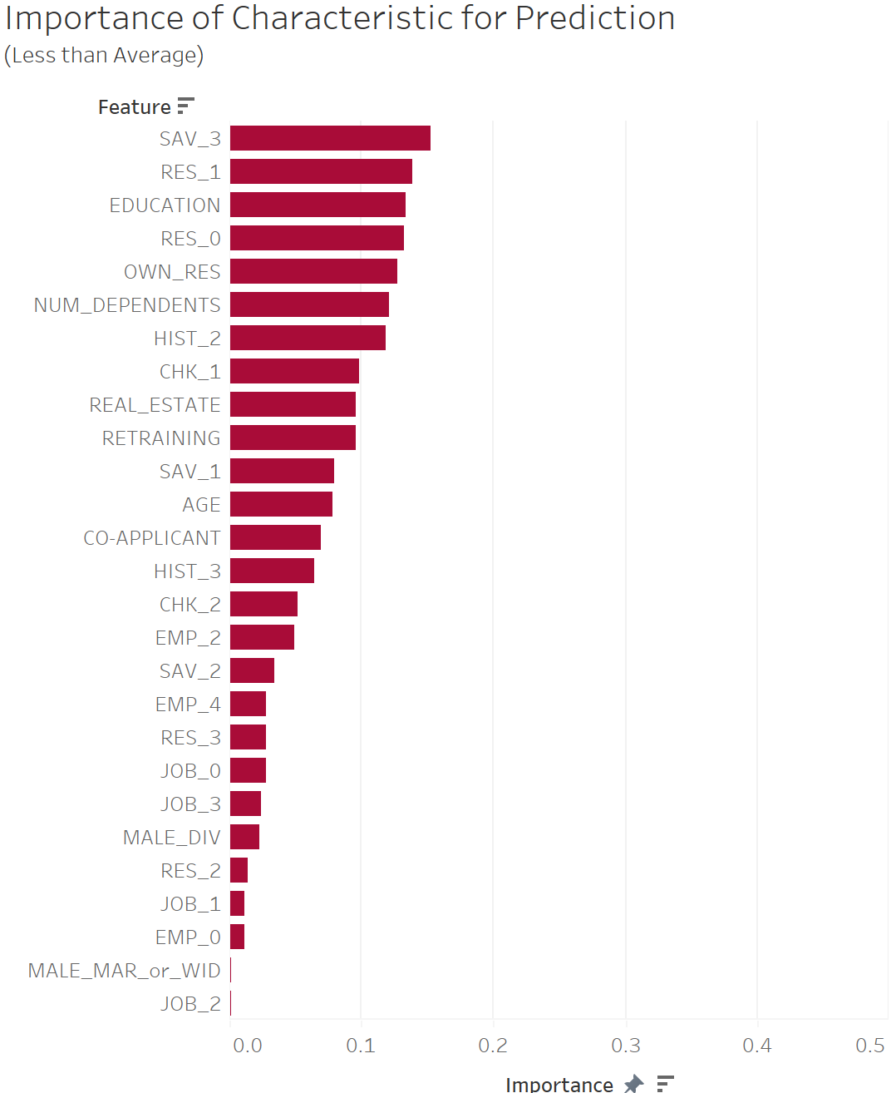
Prediction Scores of New Applicant Characteristics

Slide 5
Loan Outcome Predictions with New Applicant Characteristics
Most Predictive of Loan Outcome
Least Predictive of Loan Outcome
Loan Amount
Presence of Checking Account
Installment Rate (As % of Disposable Income)
Loan Purpose for Used Car
Applicant Renting Residence
Duration of Loan (Months)
Single Male Applicant
Married, Widowed, or Divorced Male Applicant
Job Nature of Applicant
Years at Current Residence
Presence of Savings Account
Age of Applicant
Presence of Co-applicant
Notes:
%

Slide 6
Deep Dive into Best Predictors of Loan Outcome
Loan Amount, Presence of Checking Account, Installment Rate

Slide 7
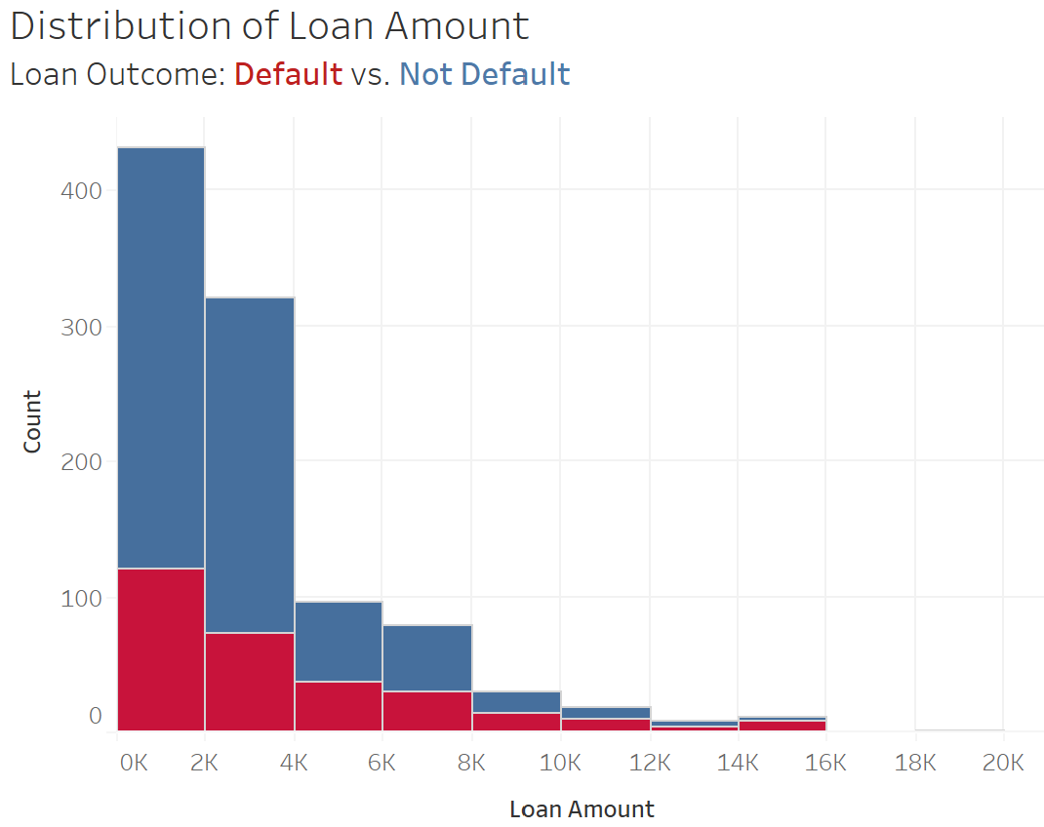
Predictor: Loan Amount
The higher the loan amount, the greater the risk of loan default.
To reduce default risk, reduce the number of larger loans.
Loan Amount | Default Rate
0-2K | 28.0%
2K-4K | 23.0%
4K-6K | 38.1%
6K-8K | 38.0%
Loan Amount | Default Rate
8K-10K | 46.7%
10K-12K | 52.6%
12K-14K | 55.6%
>14K | 75.0%

Slide 8
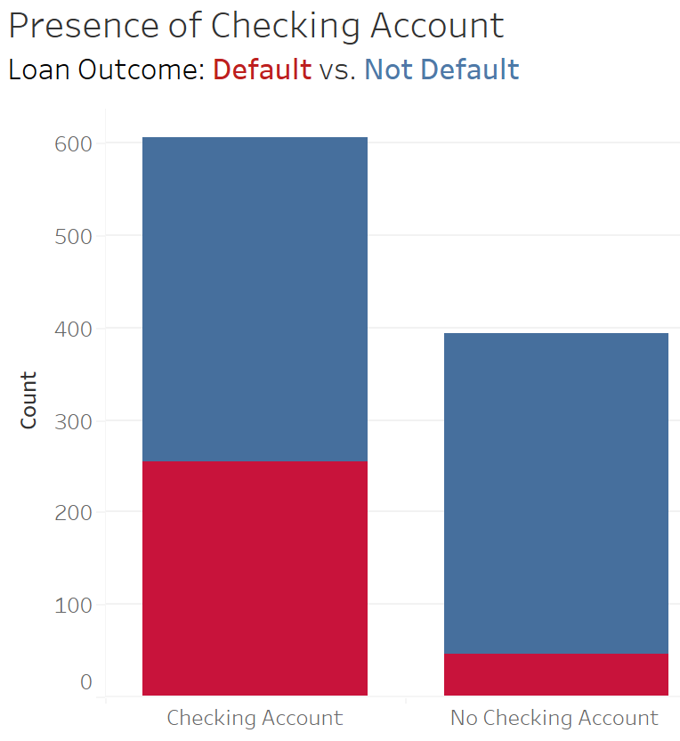
Predictor: Presence of Checking Account
Applicants that do not have a checking account are less likely to default than those with a checking account.
To reduce default risk, market to those who don’t have checking accounts.
Checking Account | Default Rate
Yes | 41.9%
No | 11.7%

Slide 9
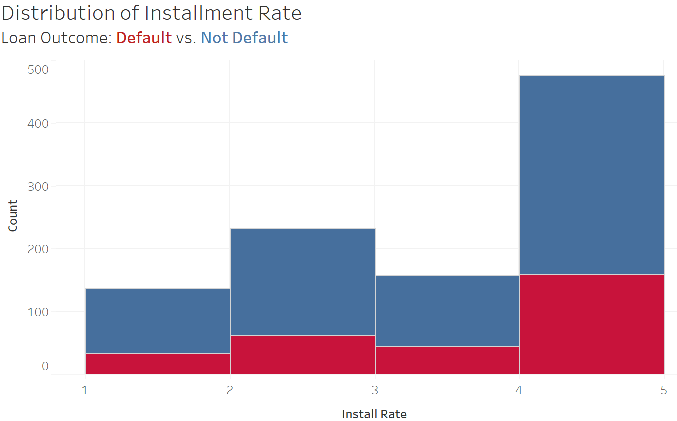
Predictor: Installment Rate
The higher the Installment Rate, the greater the likelihood of default.
To reduce default risk, minimize the installment rate.
Installment Rate | Default Rate
1 | 25.0%
2 | 26.8%
3 | 28.7%
4 | 33.4%

Slide 10
Deep Dive into Worst Predictors of Loan Outcome
Job Nature of Applicant, Years at Current Residence

Slide 11
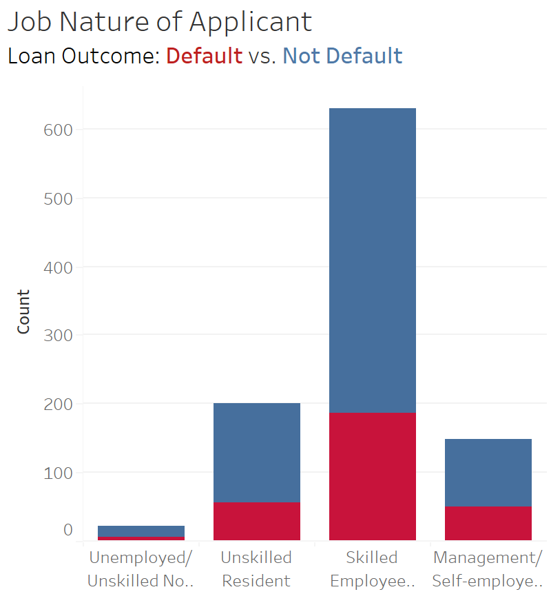
Predictor: Job Nature of Applicant
No discernable differences in applicant job nature and default rate.
Job Nature | Default Rate
Unemployed | 31.8%
Unskilled | 28.0%
Skilled | 29.5%
Highly Qualified | 34.5%

Slide 12
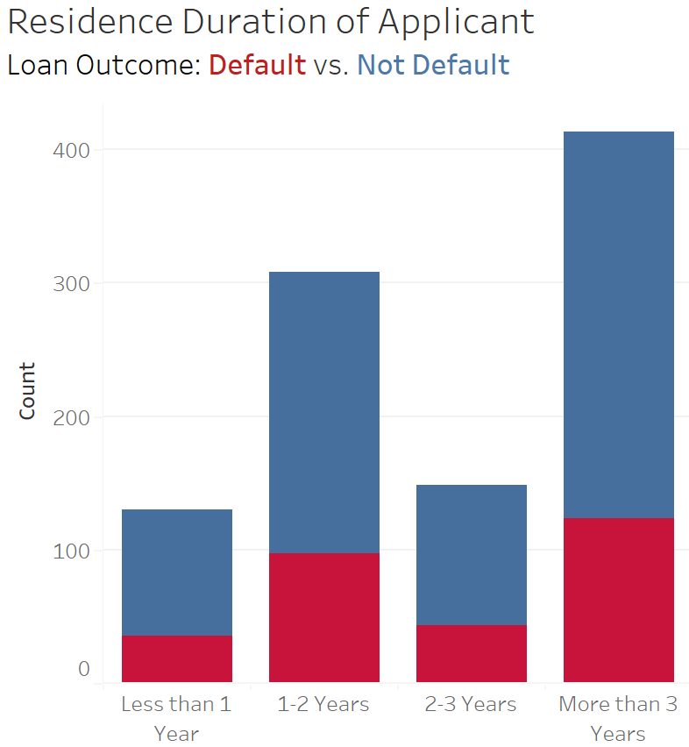
Predictor: Years at Current Residence
No discernable differences in applicant’s years at current residence and default rate.
Years at Current Residence | Default Rate
Less than 1 | 27.7%
1-2 | 31.5%
2-3 | 28.9%
More than 3 | 30.0%

Slide 13
Next Steps
Applying the Results

Slide 14
Next Steps
Review current application process to ensure we are gathering information for most predictive characteristics and not spending too much time obtaining information for poor predictive characteristics
Use model to predict the likelihood of current in-force loans to default and try to take proactive steps to prevent this from occurring
Work with underwriting teams to see how current model can be utilized to determine future loan approvals

Slide 15
First Help Financial Loan Default Risk Analysis
Scott Hunter

